Slide 1
Distributed Components and Futures:
Models and Challenges
Ludovic Henrio
A Distributed Component Model
Distributed Reconfiguration
Calculi for Components and Futures
Behavioural Models
FMCO 2008

Slide 2
A DISTRIBUTED COMPONENT MODEL

Slide 3
What are (GCM) Components?
Bindings
NF (server) interfaces
Composite component
Client
interfaces
Server
interfaces
Primitive component
Business code
Primitive component
Business code

Slide 4
A Primitive GCM Component
CI.foo(p)
Primitive components communicating by asynchronous remote method invocations on interfaces (requests)
Components abstract away distribution and concurrency
in ProActive components are mono-threaded
➔ simplifies concurrency but can create deadlocks

Slide 5
Composition in GCM
Bindings:
Requests = Asynchronous method invocations

Slide 6
Futures for Components
f=CI.foo(p)
……….
f.bar()
f.bar()
Component are independent entities
(threads are isolated in a component)
+
Asynchronous method invocations with results
⬇
Futures are necessary

Slide 7
Replies
…
…
…
f=CI.foo(p)
f.bar()

Slide 8
First-class Futures
…
…
…
f=CI.foo(p)
CI.foo(f)
CI.foo(f)
Only strict operations are blocking (access to a future)
Communicating a future is not a strict operation

Slide 9
First-class Futures and Hierarchy
Without first-class futures, one thread is systematically blocked in the composite component.

Slide 10
First-class Futures and Hierarchy
… … …
Almost systematic dead-lock in ProActive
A lot of blocked threads otherwise

Slide 11
Reply Strategies
In ASP / ProActive, the result is insensitive to the order of replies (shown for ASP-calculus)
Ongoing experiments with different strategies

Slide 12
A Distributed Component Model with Futures
Primitive components contain the business code
Primitive components act as the unit of distribution and concurrency (each thread is isolated in a component)
Communication is performed on interfaces and follows component bindings
Futures allow communication to be asynchronous requests

Slide 13
RECONFIGURATION AND ASYNCHRONOUS COMPONENTS

Slide 14
Stopping GCM Components
A preliminary step for reconfiguration
Stop a component and all its subcomponents (recursive)
Synchronise autonomous entities
Deadlocks might appear if a component is stopped too early
Reach a quiescent state = all the inner components have an empty request queue

Slide 15
Possible Deadlocks in a Stopping Algorithm
Stopped
Filtering
Blocked
Stopped

Slide 16
Principles of the Algorithm
For the composite component to be stopped (master):
First phase = mark outgoing requests
Second phase:
  Filter incoming requests (only marked ones)
  Trigger final stop when all the subcomponents are ready
For the inner components
Only during the second phase
  2 phases stop with a Ready to Stop intermediate state
  Watch the status of subcomponents and propagate the final stop signal

Slide 17
Implementation (ongoing)
Require control on requests to:
  Filter
  Mark outgoing requests
  Transmit marks
  A tagging mechanism for component requests
Extend Fractal’s / current GCM’s lifecycle controller
Experiments have been conducted on a prototype, without automatic tagging
Complete and general implementation ongoing.
An algorithm synchronising the stopping process for GCM components:
Asynchronous
Hierarchical
Reach a quiescent state

Slide 18
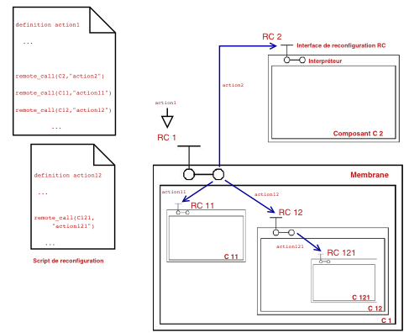
Distributed Reconfigurations
Extension of Fscript+ component model
Distributed interpretation of reconfiguration scripts
Components can interpret reconfiguration scripts autonomously
➔ Toward autonomic distributed components

Slide 19
Toward Autonomic Components
Componentize the design of NF features
NF interfaces are pluggable
NB: The design of the component membrane can also be componentized
Each GCM component is also independent from the management point of view
➔ Autonomic distributed components

Slide 20
CALCULI FOR COMPONENTS AND FUTURES

Slide 21
ASP Calculus Summary
An Asynchronous Object Calculus:
  Structured asynchronous activities
  Communications are asynchronous method calls with futures (promised replies)
  Futures ⇒ data-driven
  synchronization
ASP ⇒ Confluence Properties
Future updates can occur at any time
Execution characterized by the order of request senders
Other calculi/languages with futures: AmbientTalk, Creol, λfut, ASPfun

Slide 22
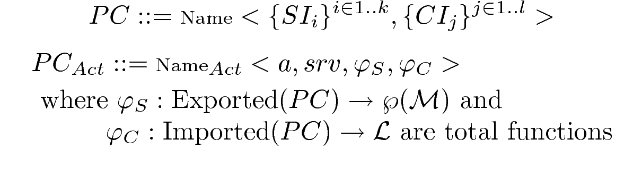
Primitive Components
Requests
A Primitive
Component
Requests
Server Interfaces
Client Interfaces
Method names
Fields

Slide 23

Hierarchical Composition
Communications have a single destination:
Composite component
Primitive
component
PC
Export
Export
Binding
Output interfaces
Asynchronous
method calls
Input interfaces
CC
PC
PC

Slide 24
Component Properties
Semantics
  Semantics as a translation to ASP
  First class futures inherited from ASP (transparent channels + properties)
Specification of deterministic components:
  Deterministic primitive components
  Deterministic composition of components
  ➔ Components provide a convenient abstraction
  for statically ensuring determinism

Slide 25
BEHAVIOURAL MODELS

Slide 26
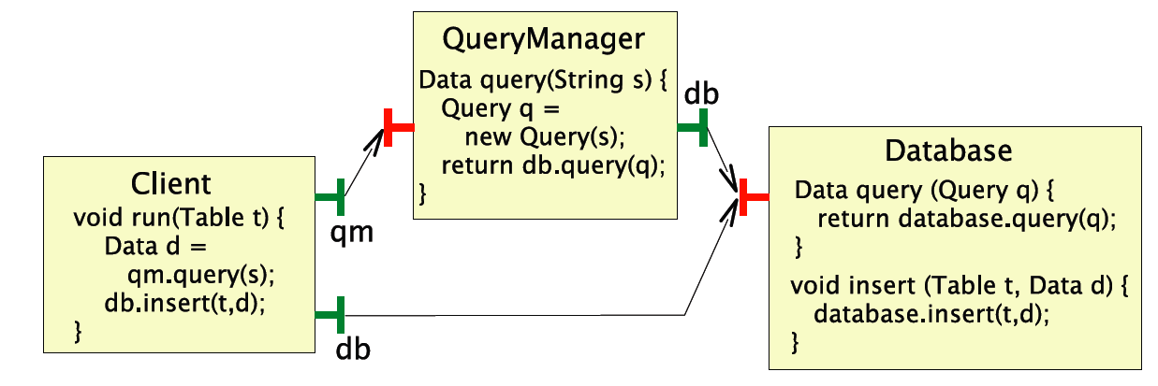
What Can Create Deadlocks?
A race condition:
Detecting deadlocks can be difficult ➔ behavioural specification and verification techniques (cf Eric Madelaine)

Slide 27
Components and Futures for Analysis
Components abstract distribution
➔ Future creation points
But future flow still to be inferred
➔ component specification language (e.g. JDC)
Components provide interface definition which can be complemented with future flow information

Slide 28
An Abstract Domain for Futures
fut(a) represent an abstract value that can be a future,
Lattice of abstract values:
if a ≺ b, then a ≺′ b, a ≺′ fut(b), and fut(a) ≺′ fut(b)
f=itf.foo(); // creation of a future
if (bool)
f.bar1(); // wait-by-necessity if bool is true
➔f.bar2(); // wait-by-necessity if bool is false

Slide 29
Behavioural Model for Components and Futures
A generic model for futures
  New lattice of abstract values
  Behavioural spec of proxies for future, with modifications for forwarding futures as request/response
  Applied to GCM components, but could be applied to other models (cf AmbientTalk, Creol, λfut)
  A strategy that guarantees that all futures are updated
To specify behaviours and prove properties, particularly deadlocks

Slide 30
CONCLUSION
AND OPEN ISSUES

Slide 31
A Model + Framework for Distributed Components
Asynchronous requests
Autonomous
Distributed
Components
Autonomous reconfigurations
Componentized NF aspects
Asynchronous + Results + Components ➔ Futures
requests
Futures are transparent and first-class
As component abstract away concurrency, concurrent aspects are easier to program and reason about

Slide 32
“Formal Results”
Calculi for futures and components
➔ language properties, e.g. determinacy
Specification and verification of component behaviour: composition, NF aspects, and futures
➔ program properties, e.g. absence of dead lock

Slide 33
Challenges
Protocols involving futures and components, like the stopping algorithm are very difficult to prove
  A general model for futures and components allowing to express protocols, i.e. manipulate requests and futures.
  Show general properties on futures, dead-locks, in a component model
Extend reconfiguration languages to introspect requests/futures status

Slide 34
Works Mentioned have been Realized with:
Marcela Rivera
Florian Kammueller
Eric Madelaine
Bernard Serpette
Muhammad Khan
Boutheina Bannour
Françoise Baude
Denis Caromel
Paul Naoumenko
Antonio Cansado
CoreGrid and GridComp partners

